Slide 1

Academic Integrity
Dr Sophie Mills, Assistant Professor in HR/OB
Business School Conduct Officer

Slide 2

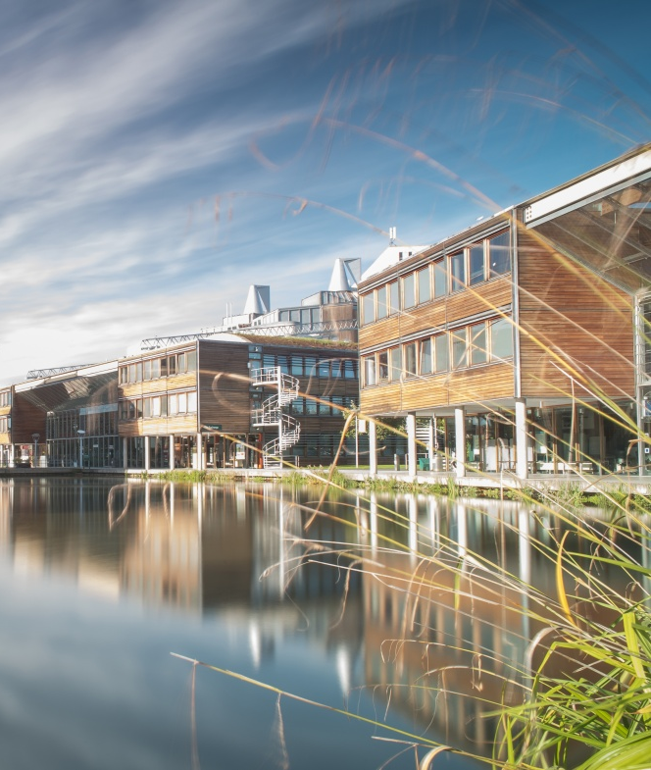
Academic Integrity
High standards of honesty, trust and professional conduct expected by the University
Protecting the value of your degree
My role as Conduct Officer is to help ensure integrity is maintained
In 2019-2020, 119 Business School students (51 - Postgraduate and 68 Undergraduate) were found guilty of academic misconduct (incl. cases of plagiarism and collusion in coursework assessment and take-home exams, and cheating in on-campus exams)
Notes:
Welcome dialogue.

Slide 3
What is Academic Misconduct?
According to the University’s Quality Manual, academic misconduct refers to:
“any improper activity or behaviour by a student which may give that student, or another student, an unpermitted academic advantage in a summative assessment”
Unacceptable in the scholarly community
Types of academic misconduct include plagiarism, collusion (including contract cheating or essay mills) in coursework assessments and take-home exams and cheating in on-campus exams

Slide 4

You should also note that:
It is our role to make you aware of academic misconduct issues and how to avoid them
It is your role to “take responsibility for the of your own work, including asking for clarification where necessary”
Proven cases may be mentioned in references or notified to an accrediting body
Familiarise yourself with Quality Manual:
http://www.nottingham.ac.uk/academicservices/qualitymanual/assessmentandawards/academic-misconduct.aspx
Notes:
Shifts in what work looks like
Human factors
Displacement of work
Technology
Social implications
Public policy and economic structures
The role of organisations
Productivity, corporate social responsibility, leadership, circular economy, stakeholder view of the firm etc

Slide 5

The Practicalities
You will not be penalised for academic misconduct via the marking process
Once any offence is suspected, you will be required to attend a Business School suspected academic misconduct meeting
If you are found guilty, a penalty will normally be imposed internally by the Business School
For second offences, you will be referred to the University’s central Academic Misconduct Committee
There is no leniency for first offences
(as you are assumed to be aware of AM)
Notes:
Welcome dialogue.

Slide 6
Penalties
For first offences, the usual Business School penalty is a mark of zero, either for the section(s) of work at the focus of the investigation, or, for the entire piece of assessment concerned
Second offence penalties are determined by the University and have previously included a mark of zero for 60 credits, a mark of zero for 120 credits, and expulsion from the University
Notes:
Welcome dialogue.

Slide 7

A Quick Quiz
Please take a few moments to complete the following plagiarism quiz
https://www.turnitin.com/static/plagiarism-quiz/
Notes:
Welcome dialogue.

Slide 8
Plagiarism (in coursework assessment or take-home examinations)
The University defines plagiarism as “representing another person’s work or ideas as one’s own”
This includes:
Improper referencing/acknowledging sources
the unauthorised use of another student’s work
the commissioning, purchase and submission of a piece of work, in part or whole, as the student’s own
Notes:
Welcome dialogue.

Slide 9
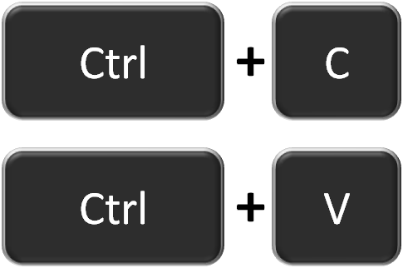
Referencing
You must follow the guidelines for referencing provided in your Student Handbook (on Moodle)
Every time you include a quote, idea or paraphrase in your work you must include an in-text reference and an end-of-text reference
You must always make explicit in text the work that is yours and the work that is taken from others
Be careful with copy & paste
Notes:
Welcome dialogue.

Slide 10
Referencing a Direct Quote
Burkitt (2012, p. 458) has suggested, “while emotion is considered in theories of reflexivity it is generally held at bay, being seen as a possible barrier to clear reflexive thought.”
OR:
It is claimed that “while emotion is considered in theories of reflexivity it is generally held at bay” (Burkitt, 2012, p.458).
End of Text References (not always required for take-home exams)
Burkitt, I. (2012). Emotional reflexivity: Feeling, emotion and imagination in reflexive dialogues. Sociology, 46, 458-472.
Notes:
Welcome dialogue.

Slide 11
In Text Citation of Academic Sources
Burkitt (2012) claims that current literature relating to reflexivity identifies emotion as problematic to reflexive thinking.
End of Text References (not always required for take-home exams)
Burkitt, I. (2012). Emotional reflexivity: Feeling, emotion and imagination in reflexive dialogues. Sociology, 46, 458-472.
Notes:
Welcome dialogue.

Slide 12
In Text Citation of Website Materials
Research in the United States suggests that up to 60% of office PCs are left on overnight, resulting in 19.82bn kWh of electricity wastage and 14.4 million tones of CO2 emissions (National Energy Foundation, 2007).
End of Text References
National Energy Foundation (2007) Assessment of Potential for Energy Savings from PC Software Management. September. Downloaded from http://www.1e.com/energycampaign/downloads/ 1ENEFReport.pdf as at 15th August 2015.
Notes:
Welcome dialogue.

Slide 13
Why is this so important?
In the real world people don’t reference, so why does this matter at university?”:
Many business reports are referenced as it adds credibility
In business, others will assume rigour in your research and that you can/could support your arguments with appropriate evidence
In academia, we want proof of your sources of evidence
For your degree this is important because we are assessing your own, individual demonstrated ability
Notes:
Welcome dialogue.

Slide 14
Collusion
“cooperation in order to gain an unpermitted advantage”
A growing number of cases occur where pieces of individual coursework have not been completed entirely individually
Please be careful to draw the line so that your own individual work remains just that
Notes:
Welcome dialogue.

Slide 15
Use of Text-matching Software
“TurnItIn” is a text-matching software that is used in the School
It is an imperfect tool against plagiarism
The Business School advises against students relying on TurnItIn or any other piece of text-matching software as a means of verifying whether or not their work may be plagiarised – although a Test my Text facility is usually available on each Moodle page up until the submission deadline
It is wiser for students to adopt an approach to referencing in their work that clearly demonstrates where their voice stops and anther voice begins
Notes:
Welcome dialogue.

Slide 16
Cheating in On-campus Examinations
This includes:
having any form of unauthorised notes or other information source on your person or at your desk
copying from another candidate
impersonating another candidate or allowing oneself to be impersonated
or having any form of data storage or communications device (such as a mobile phone) on your person or at your desk
Notes:
Welcome dialogue.

Slide 17
Do let us help you!
If in doubt, please ask your tutors/convenors for help
In many AM meetings we learn that people have been experiencing medical or personal problems that we could have helped them with
The Business School’s Welfare Manager – Liza Aspell – who you can talk to confidentially
Please ask academics, your programme admin team or Liza Aspell for help if you are experiencing difficulties
Notes:
Welcome dialogue.

Slide 18
Thank you for your attention!

